Slide 1
Entertainer Data Analysis
Presented By: Devika Babu Kadavil

Slide 2
Introduction
Normal life can be stressful, and people need to relax. Being entertained by others is a wonderful way to take some time out of life. It can reduce stress and make life's issues easier to face. The media and entertainment industry consists of film, television, radio and print. These segments include movies, TV shows, radio shows, news, music, newspapers, magazines, and books. The entertainment industry is a group of sub-industries devoted to entertainment. The entertainment industry is used to describe the mass media companies that control the distribution and manufacture of mass media entertainment

Slide 3
Problem Statement
The entertainment industry relies heavily on data for insights into trends and audience preferences.
This report analyzes entertainer data, focusing on Singer and Actor Profession.
We aim to extract actionable insights for entertainers and their teams.
Key objectives include the top Oscar winners list, and the top 10 Entertainers with the most awards
Aiming to optimize strategies and engagements in the industry.

Slide 4
Data Set
Entertainer-Basic Info: It consists of list of 70 Entertainers Name, Birth year and Gender
Entertainer-Breakthrough Info: It consists of details about the 70 entertainers like breakthrough year, first major award, breakthrough movie name
Entertainer-Last major work Info: It consists of the details about the 70 entertainers last major work and if died, Year of death details

Slide 5
Main KPI’s
Visualization of Singers & Actors with their respective awards.
Awards Distribution
Entertainer with their Profession
Top Entertainer with Big Number of Awards
Visualization of Total Nominees & Total Awards Won
Top Entertainer with their different type of Winning Awards

Slide 6
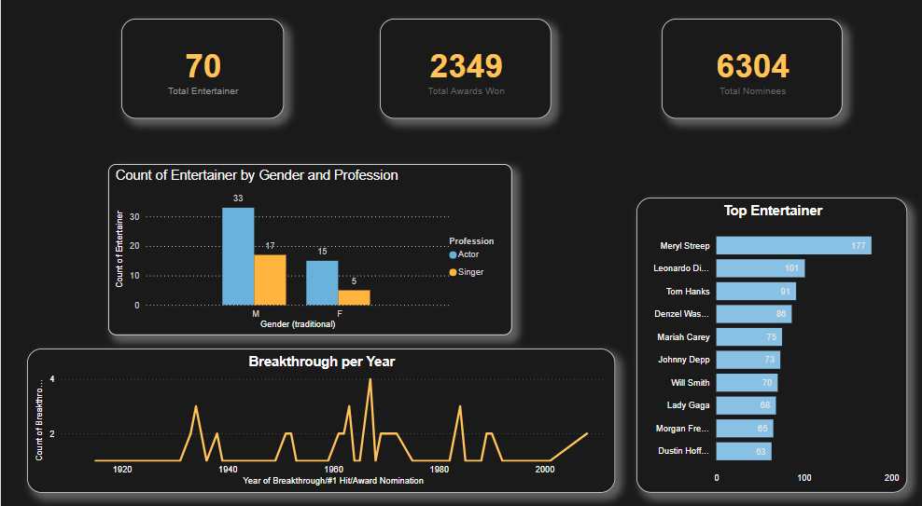
Mock Dashboard

Slide 7
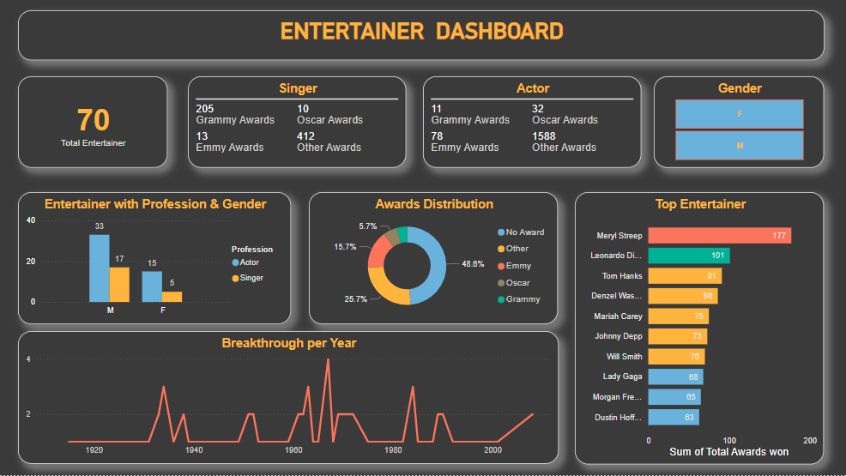
Entertainer Dashboard

Slide 8
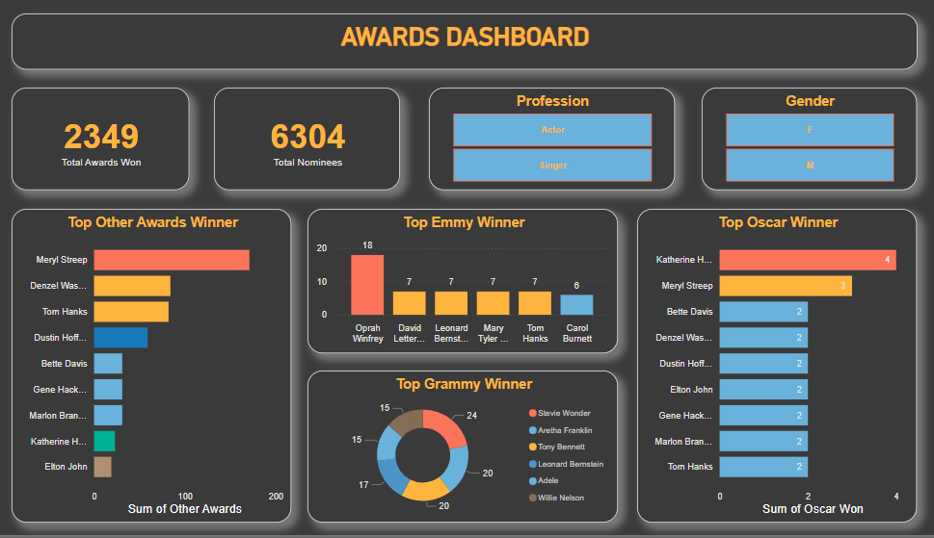
Awards Dashboard

Slide 9
Insights
Top 3 entertainers are Meryl Streep, Leonardo DiCaprio & Tom hanks with most awards.
Meryl Streep is the best entertainer with 177 total awards including 3 Oscars, 3 Emmy and 171 others.
Katherine Hepburn won most numbers of Oscars(4).
Oprah Winfrey won most number of Emmy Awards(18).
Stevie Wonder won most number of Grammy Awards(24).
Actors wins the most awards(1709) as compared to Singers(640).
There are 71.5% male entertainers and 28.5% female entertainers.

Slide 10
Thank You

